Slide 1
Public Relations Practice in ASEAN Economic Community: Friendship & Mutual Understanding Among ASEAN PR Practitioners
Kathy O’Brien
Managing Director
5th February 2015

Slide 2
ASEAN Economic Community
Single market and production base
10 nations
An opportunity for us all
Free flow of goods
and services
Asia-Pacific hub
600 million
people
Single market by end-2015

Slide 3
Challenge #1
Practical ‘borders’ remain
Urban vs rural
Language/dialect
Customs
PR advisors will need complex networks

Slide 4
Ethical Challenges
Transparency
Integrity of channels
Social justice

Slide 5
Transparency
Fake blog – flog – flack blog
Astroturfing
‘Material connections’ between reviewers and brand owners

Slide 6
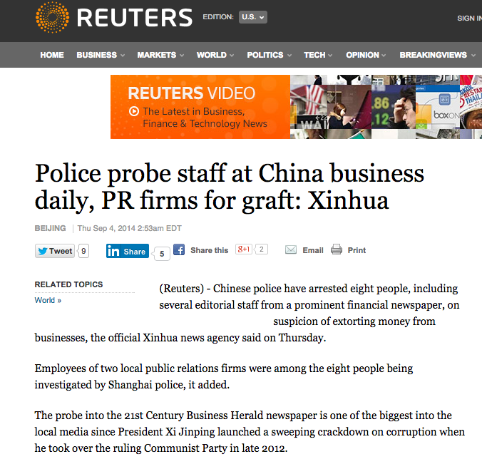
Integrity of Channels
Corrupting the integrity of ‘channels’ eg media
Paying for positive coverage
Paying to avoid negative coverage

Slide 7
Social Justice
‘Obligation to serve the interests of society’

Slide 8
Our World is …
complex

Slide 9
A Recommendation
Every market:
Adopt and share a
Code of Ethics

