Slide 1
Singtel Story on Global Expansion
ASEAN Summit for State Owned Enterprises and Media
6 Feb 2015

Slide 2
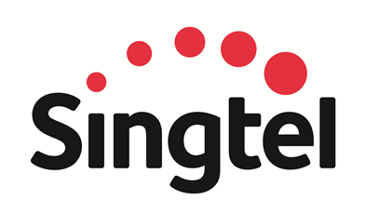
Singtel has 532 million mobile customers in 25 countries
Who we are
#1 in Thailand
23%
#1 in India
32%
4
#2 in Philippines
47%
2
5
6
1
3
11
7
8
12
13
Africa
9
14
10
15
17
16
#1 in Singapore
100%
#1 in Indonesia
35%
#2 in Australia
100%
Bharti Airtel’s Shareholding
Africa
1.Sierra Leone 100%
2.Burkina Faso 100%
3.Ghana 75%
4.Niger 90%
5.Nigeria 79%
6. Chad 100%
7.Gabon 90%
8.Congo Brazzaville 90%
9.DR Congo 99%
10.Zambia 96%
11. Uganda 100%
12. Rwanda 100%
13. Kenya 100%
14.Tanzania 60%
15. Malawi 100%
16.Madagascar 100%
17.Seychelles 100%
Source: Singtel Financial Data

Slide 3
Our key milestones in Singapore
Rebranding Exercise
1879
2012
1955
1992
1993
1997
2000
2005
2009
2015
Telephone introduced
in Singapore
Liberalisation of mobile market
Corporatisation of Singtel
Launched
3G network
Launched 4G network
Organisational Restructure
STB
(statutory board)
Full liberalisation of telecoms market
Listing on
SGX
Introduced NextGen NGN

Slide 4
Our key milestones for global investments
1992 - 1996
Cambridge Cable (UK)
1995 - 1998
Stjarn TV (Sweden)
1992 - 1999
NetCom (Norway)
1989
Infonet, Centigram and MTel (USA)
2014
Kontera (Israel)
1995 - 2004
Belgacom (Belgium)
1993
Globe (Philippines)
1
2012
Amobee (USA)
1999 - 2007
NCIC (Taiwan)
2014
Adconion (USA)
1999
AIS (Thailand)
2000
Airtel (India)
2010
Zain (Africa)
Acquisition through Airtel
2001
Telkomsel (Indonesia)
2007 - 2013
Warid (Pakistan)
1995 - 1999
AAPT (Australia)
2005
Citicell (Bangladesh)
2001
Optus (Australia)

Slide 5
Singtel : A transformation story
Statutory board
Public-listed company
Reliance on fixed/IDD
Diversified product lines
Singapore-centric
Balanced geographical mix
Domestic player
Regional player
Incumbent in Singapore
Largest Asian telco
outside China
Traditional telco
ICT company

Slide 6
Our regional expansion focused on entering markets with good growth prospects and where we could add value
We invested when the mobile business was just starting
#2 in Australia
We chose to work with strong local partners…
MOBILE
#1 in India
#1 in Indonesia
… contributed our business and technical expertise in telecom …
#2 in Philippines
… and helped them become leading players in each of their local markets
#1 in Thailand

Slide 7
Financial highlights
In SGD million
3,681
3,610
Revenue*
48%
2,337
59%
85%
27%
52%
41%
15%
FY01
FY08
FY14
73%
SGD /Rupiah:
5,555
6,565
-32%
9,617
SGD /Rupee:
26.93
27.35
-44%
48.72
Singapore
Outside Singapore
Group’s NPAT (excluding Associate Contribution & EI)
Share of Associates’ profits after tax
* If we include the proportionate share of the Associates’ revenue for financial year ended 31 Mar 2014
Source: Singtel Financial Data

Slide 9
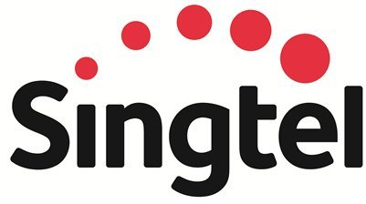
Singtel re-branding
The new logo is marked by a signature red arc that reflects innovation and the ongoing evolution of the business. It symbolises Singtel’s commitment to customers to make everyday better with its service, technology and content, and to deliver experiences that are seamless and effortless in everything they do – at home, at work and when doing their favourite things.
The word “Singtel” bears friendlier curves and rounded corners to show the company is approachable, caring and optimistic. The lower case “t” celebrates the company’s heritage as a telco and marks its transformation into a leading multimedia and ICT services company.

