Slide 1
Cross Cultural & PR in AEC
A case of Bio Farma
By N. Nurlaela Arief, MBA.MIPR
Notes:
Ladies and gentlement ......good afternoon .. Thank you for the opportunity...
Today I’d like to share a very interesting story

Slide 2
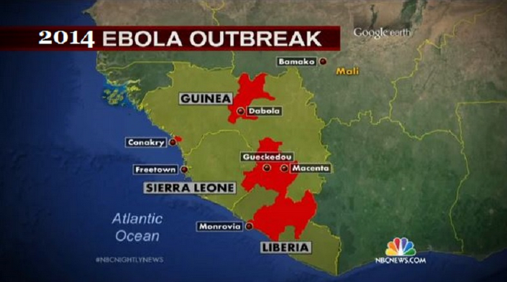
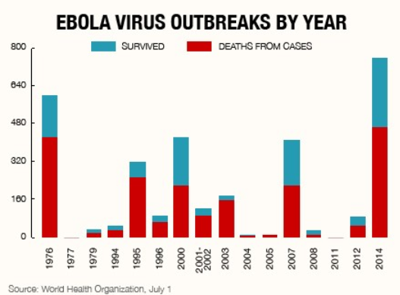
“The pandemic is the largest deadly diseases in history”

Slide 3
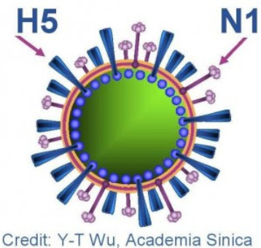
The transformation of virus is faster than the invention of vaccine itself
Notes:
actually, this is not the first time, we still remember, about 2 years ago, there are MERS, swine flu, HINI, H5N1 and a few years earlier there were also smallpox,

Slide 4
SMALLPOX = CACAR API
GLOBAL SMALLPOX CASES : 1920-1980
Killed almost 600.000 people
Notes:
Ladies and Gentlemen , ......just Imagine, what if Taylor Swift.. an american sweetheart, a seven-time Grammy winners. if she was born in 1920, she may be infected smallpox or cacar api. According to World Health Organization, The diseases cause by Ebola virus, Smallpox and Swine Flu.. the most effective treatment for all infectious diseases is.. Vaccine trough immunization. Vaccine is proved save lives..
Today we can amaze and enjoy ... Beautiful Taylor Swift ... We can see here ... everyone.. PR Practitioners, PR Experts, the media all beautiful, handsome with a perfect health. Thank you to Vaccine.. And absolutely for Indonesian People thank you to Bio Farma As the only vaccine manufacturer in Indonesia

Slide 5
The Role of Public Relations
of Biotech Company in ASEAN and Global
Notes:
Ladies and gentlement , everyone, We gather here to discuss PR Practice in ASEAN Economic Community.
from my experiences .. it’s not easy as a public relations to support, maintain and enhance our corporate reputation. Especially for biotech company like Bio Farma, Sometime there are a lot of questions from my friends, “hi Lala... What is the different of vaccine and medicine? .. And In detail here are our role

Slide 6
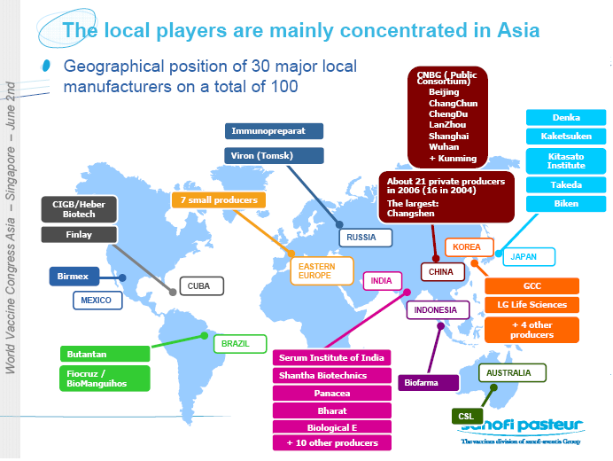
Vaccine Producer in Asia Pacific and Emerging Countries
VACCINE produced by Bio Farma has been assured throught The Prequalification from WHO, beside fulfill Indonesia Market
We also fulfil need for more than 123 countries.
 | year | Vaccine
1 | 1997 | OPV, measles 10 ds
2 | 2001 | DTP, DT, TT (vial)
3 | 2003 | TT (Uniject)
4 | 2004 | Hep B (Uniject)
 | year | Vaccine
5 | 2006 | DTP/HepB, measles 20 ds
7 | 2009 | mOPV1
8 | 2010 | bOPV (1,3)
9 | 2011 | Td
10 | 2014 | Pentabio
Notes:
Here are Vaccine producer in Asia pacific and emerging countries.. .. The player of vaccine in every countries is limited by number,.
Indonesia only Bio Farma , China.... India, .. Russia... Mexico... Brazil ...
VACCINE produced by Bio Farma has been assured for safety, quality and efficacy throught The Pre-qualification from WHO, beside we fulfill Indonesia Market We also fulfil the need for more than 130 countries.

Slide 7
GLOBAL HEALTH SECURITY
Bio Farma
Republic of Indonesia
WHO
(World Health Organization)
DCVMN
(Developing Countries Vaccine Manufacturers Network)
OIC
(Organization of Islamic Countries)
Self-Reliance of Vaccine Production
(KEMANDIRIAN VAKSIN NASIONAL)
Self-Reliance in
Islamic Countries
Availability and supply of Vaccine for Developing and less developing countries trought UNICEF/GAVI
Availability, supply
Affordable and High Quality
Vaccine in Dev. Countries)
Notes:
Our strategic role in global health security : We also play an active role in improving the availability and self-reliance of vaccine production in developing countries and Islamic countries to maintain the Global Health Security

Slide 8
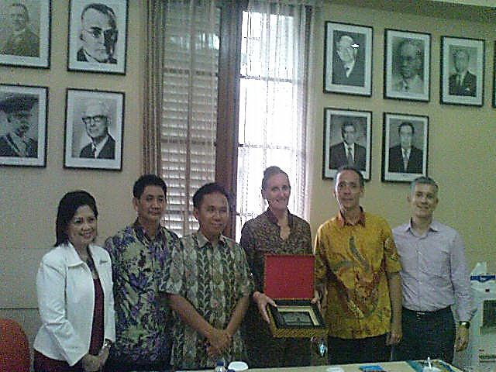
Access to Medicine & Healthcare
Bio Farma colaborating with UNICEF in the frame of enhancing Access to Medicine & Healthcare in developing countries & less developing countries
Donation of Vaccine to Tajkistan, Iran, Tunisia,
Timor Leste, Africa.
Notes:
Bio Farma collaborating with UNICEF to enhance Access to medicine and health care in developing and less developing countries,
And Donation of vaccine to remote country and conflic country such as Iran, Tajkistan, Tunisia, Timur Leste, Africa and others.

Slide 9
Our Philosophy “Dedicated to Improve Quality of Life”
Quality
Water
Cold Chain
Create Share Value & Solution
Our Expertise
VALUE &
SOLUTION
SME
DNA
Virus/
Bacteria
Purification
Harvesting
Air
Environment
Notes:
Everyone....
Our philosophy is “dedicated to improve quality of life, our experience for more than 125 years, we have an expertise in managing and developing purefication, harvesting, environmet, air, reengineering for DNA virus and bacteria, water, quality and cold chain system, we transfer our expertise trough
Create share value, we give a solution to community and small medium enterprises (sme)

Slide 10
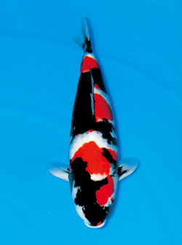
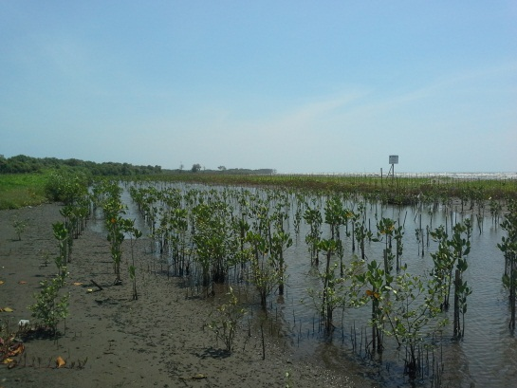
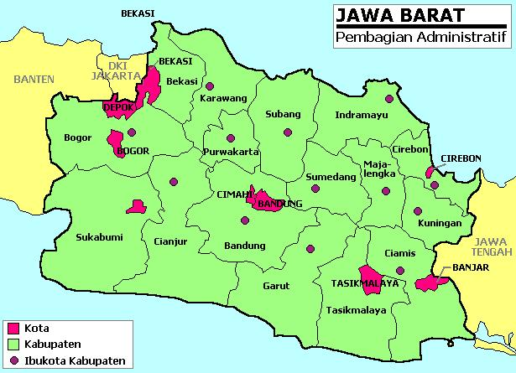
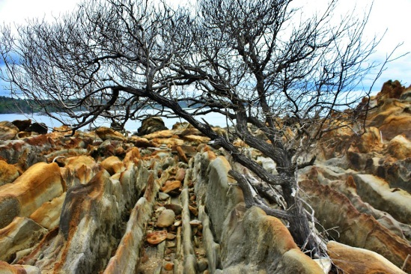
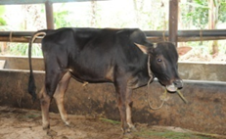
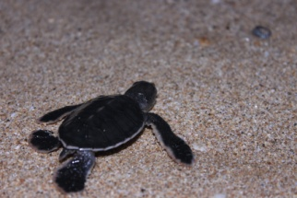
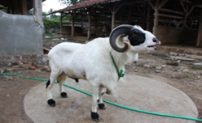
The Implementation of Value “Biotech for Community & SME”
Karangsong
SIKLUS
Mangrove
Bandeng
MIZUMI Koi
National the best
Koi Breeder
Implemented Biosecure
Rancah
KTSR
Sapi Rancah
(Cow)
Ciletuh Geopark
Wanajaya
KTKJ
“Domba” Sheep of Garut
Pangumbahan
KKPS
Penyu
Notes:
As an example of implementing our value ....biotechnology for community and sme, here are the result
(mention only domba and koi)

Slide 11
Batik Pakidulan is an eco-friendly and green product,
Implemented green process biotech with nano technology
13 batik pakidulan disain has owned Copyright – IPR
Inspired by the exotic and natural charm, cultural and bio-diversity Of Geopark Ciletuh – Sukabumi West Java
Notes:
Now.. Our activities, beside maintaining corporate reputation strategy for all stakeholders in Indonesia and Global., we also integrate corporate communications strategy with CSR activities,
Such as socializing and sharing to the media about the success story of our CSR partner and the initiative of Corporate in the field of social and environment aspect. For example Almost 2 months we share stories about batik pakidulan in alot of media in Indonesia,, today i am also wearing batik pakidulan ☺ if you are interested in this please visit batik pakidulan booth in this summit.

Slide 12
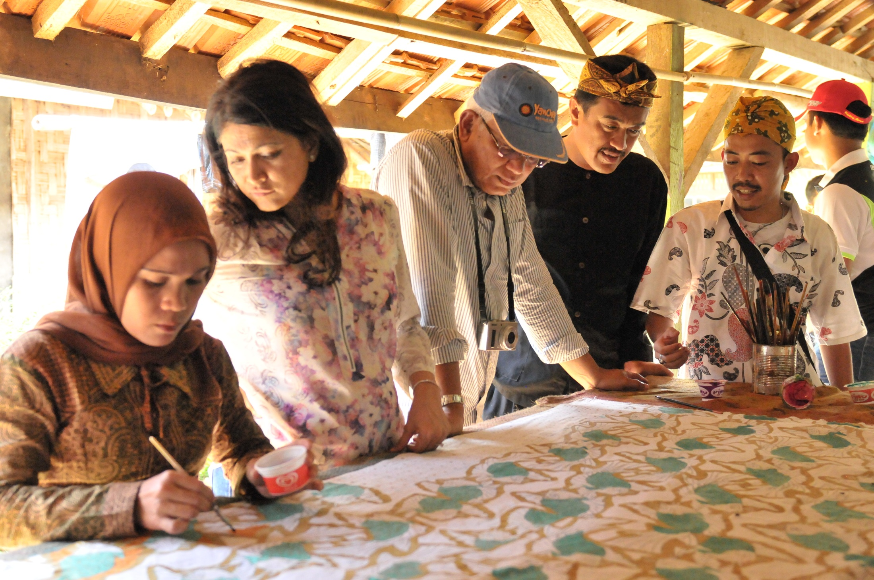
Prof. Ibrahim Komoo,
The President of Asia Pacific Geopark Network (APGN)
Notes:
Here is Prof. Ibrahim from Malaysia, (the third from left) he is the president of APGN, who has visited our batik pakidulan artist, in Sukabumi – West Java on December, 2014

Slide 13
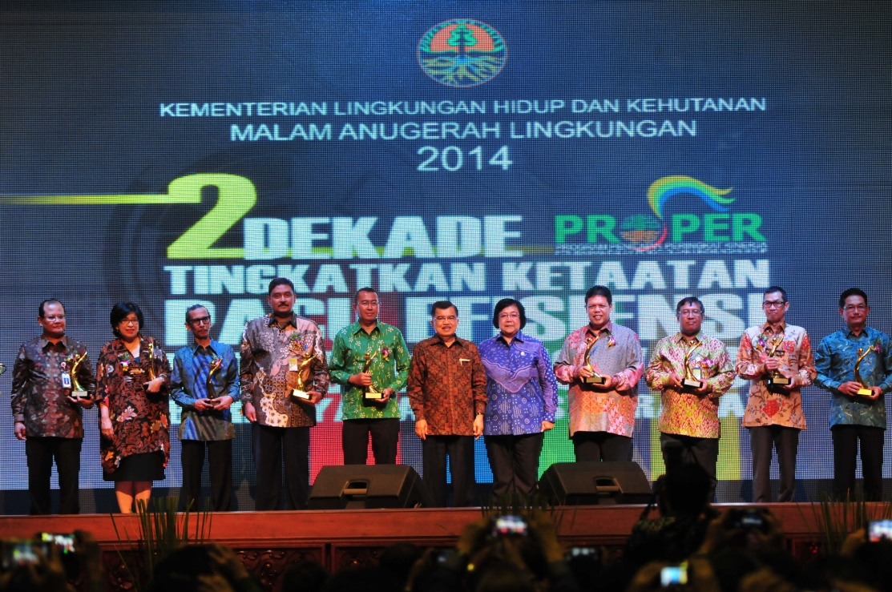
GOLD PROPER
The highest appreciation and acknowledgement as a prove of environmental awareness and successful community development, that a company has been implementing environment comprehensively and sustainably (beyond compliance)
GOLD PROPER Assessment and rank of 1908 industry in Indonesia from Ministry of Environment and Forestry
December 2, 2014
Notes:
After Bio Farma winning Green Proper for 5 times, we finally got the highest appreciation and acknowledgment of GOLD Proper,
This is the proof of .....

Slide 14
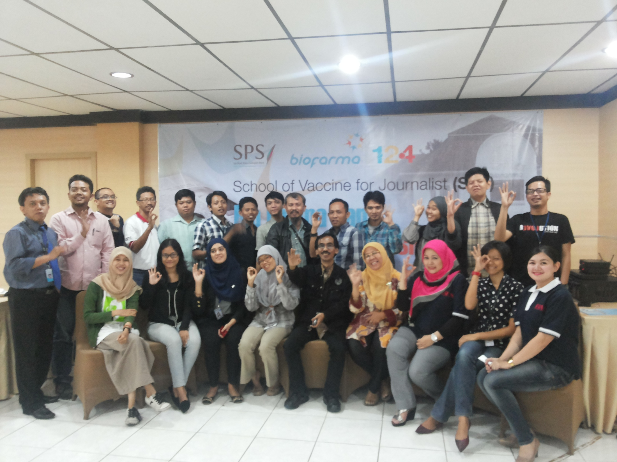
School of Vaccine For Journalist (Jakarta),
18-19 August 2014
Notes:
Education and socialization about vaccine, immunization, virus, biotechnology to public and media, its not easy, for that, we are collaborating with SPS,
Here with mr. Asmono from SPS.. we held school of vaccine for journalist, this program was succesful held in 2 cities jakarta and bandung, with the result this book “jurnalis bicara tentang vaksin” today all media will have the book.

Slide 15
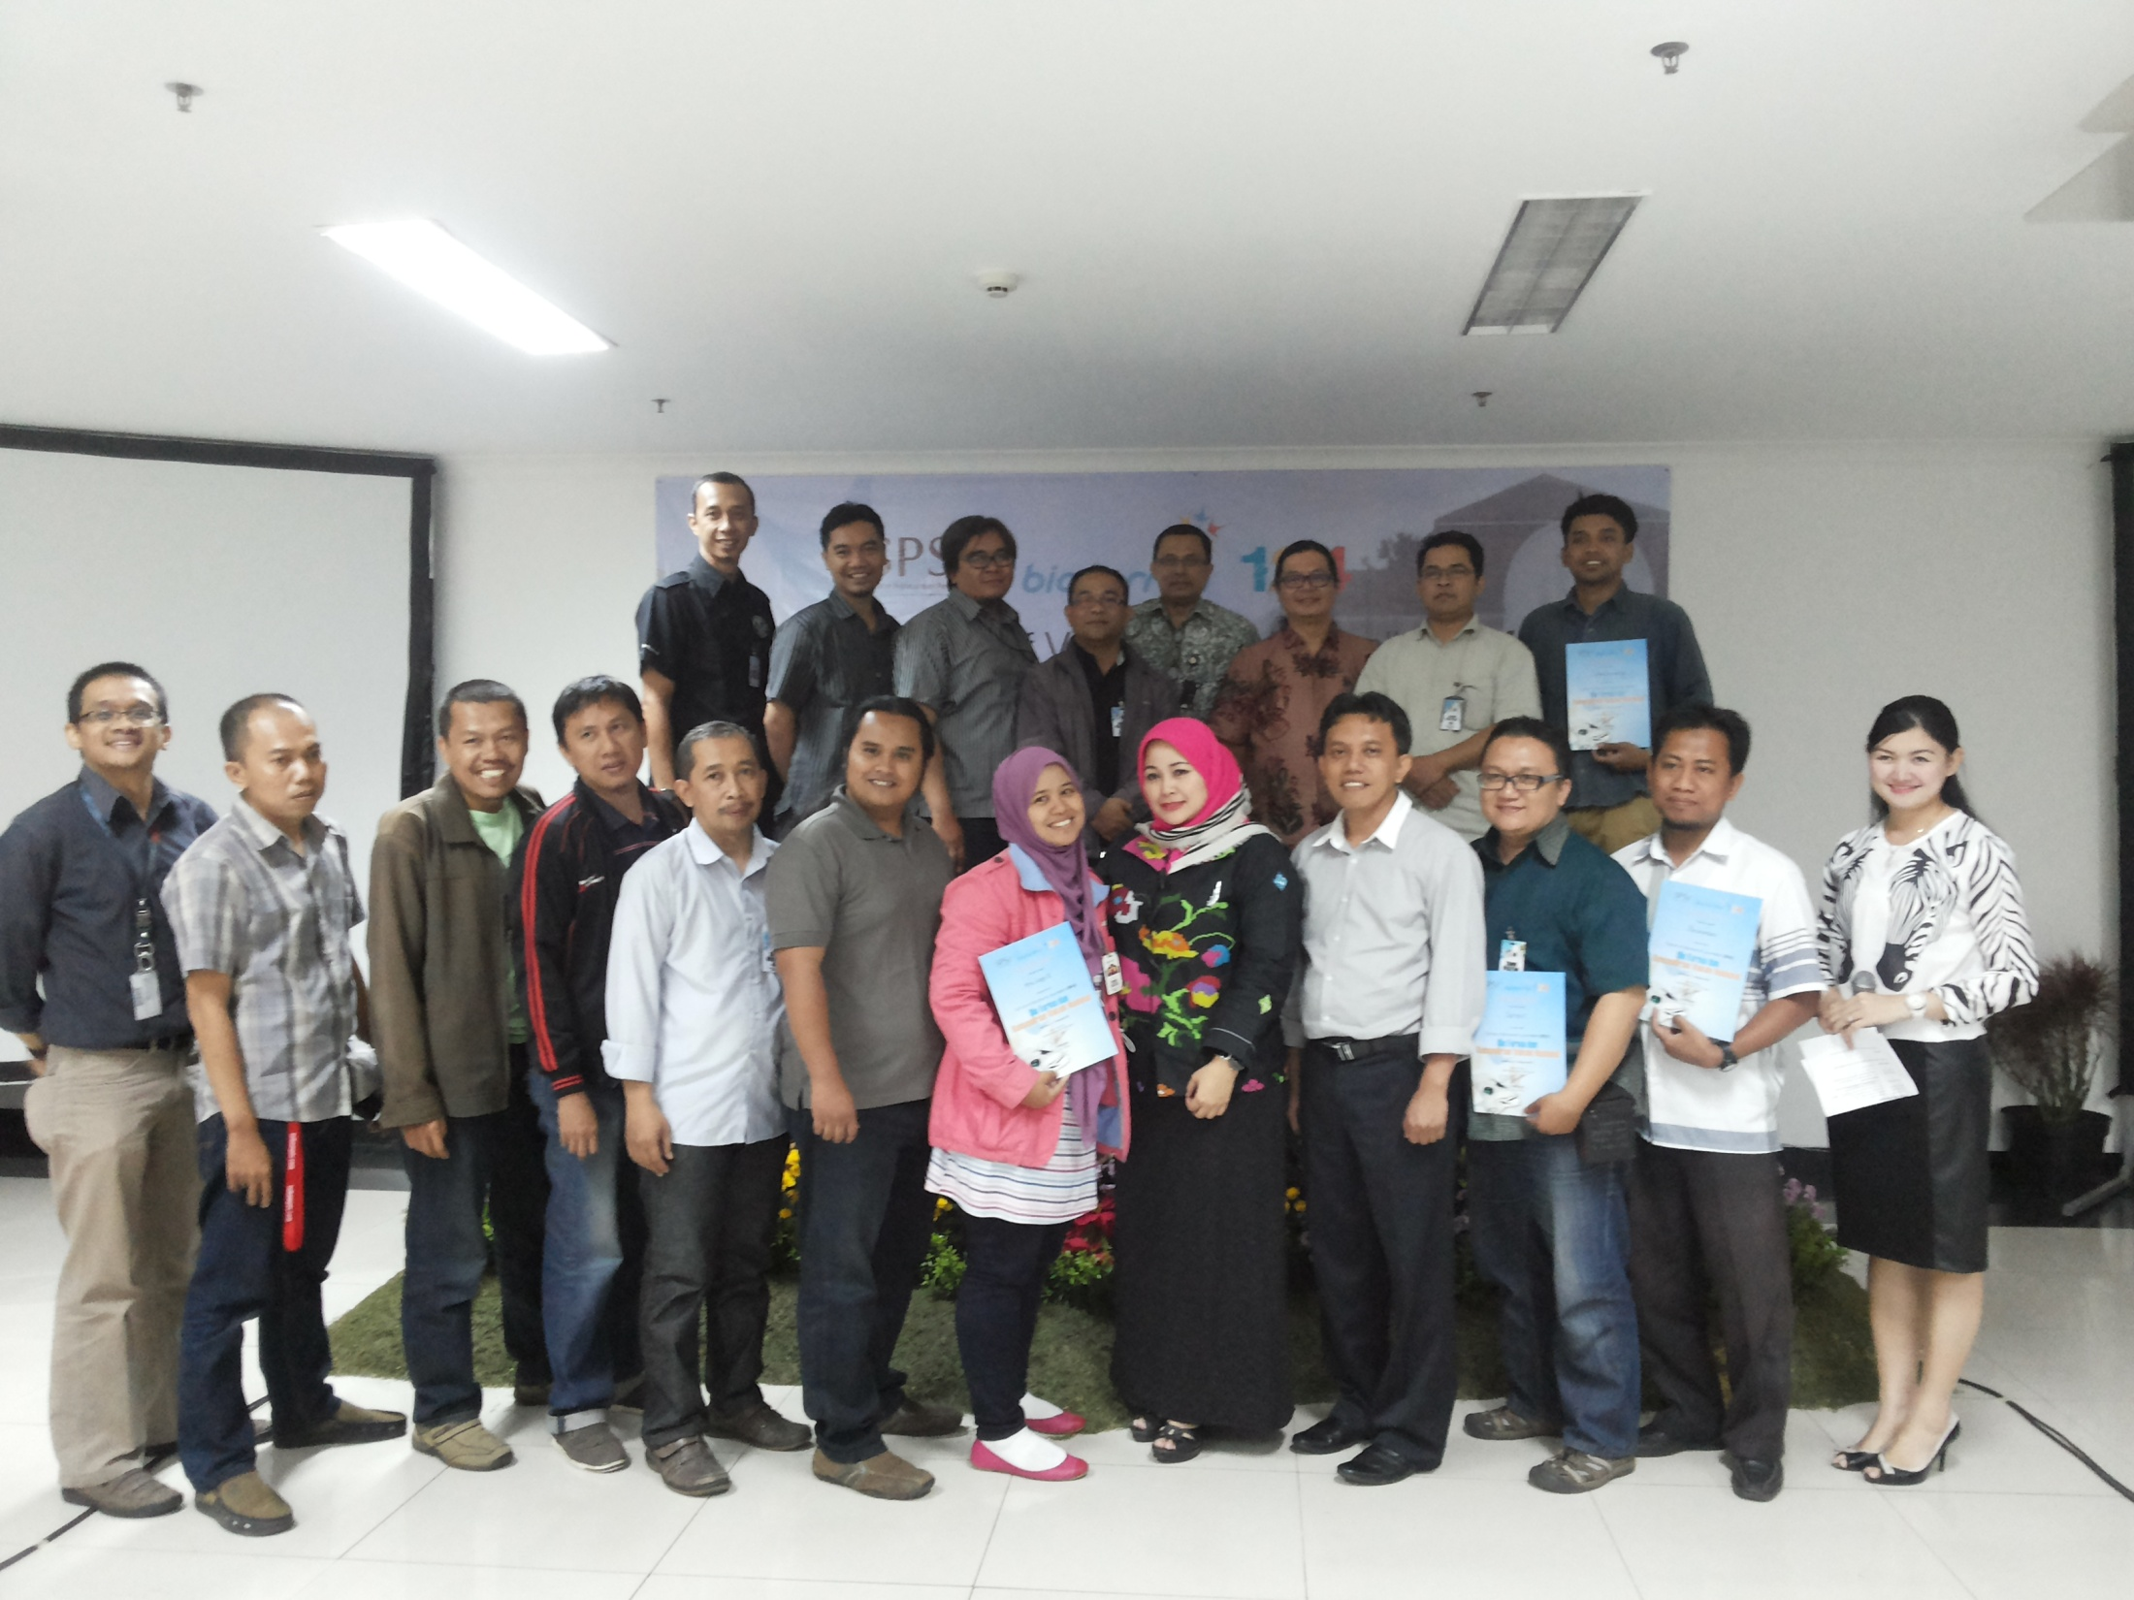
School of Vaccine For Journalist (Bandung),
11-12 August, 2014

Slide 16
International journalist visit to Biofarma
Notes:
As the International Journalist from USA such as New york Times, journalist from France, Belgium, and Australia has been visited Bio Farma on last Dec
Now we also would like to invite the journalist , media from ASEAN who gather here.. to visit Bio Farma.
And for now.. Before you visit our headquarters in Bandung, I would like to show you, the video profile of Bio Farma. Enjoy...

Slide 17
Hatur Nuhun – Thank You
Notes:
Thank you...

