Slide 1
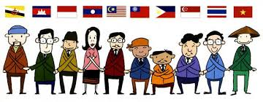
“Public Relations Practice in ASEAN Economic Community: Friendship & Mutual Understanding Among ASEAN PR Practitioners”
Parichart Sthapitanonda, Phd.
Professor, Faculty of Public Relations, Faculty of Communication Arts, Chulalongkorn University, Thailand 10330 sparicha@yahoo.com

Slide 2
As Public Relations Professioners (PRP), we need to “Put” ourselves into others’ position, To “Recognize” both the commonality & differences we share, and to “Practice” in managing “trust” among stakeholders”
Parichart Sthapitanonda
Professor, Chulalongkorn University

Slide 3
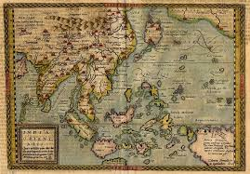
Our Long History of “Relationships”: Friends or Foes
Notes:
May require more than one slide

Slide 4
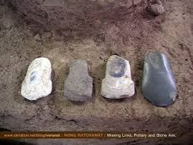
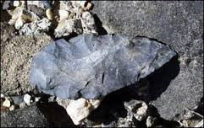
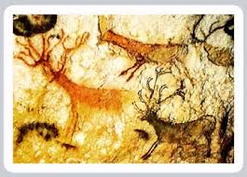
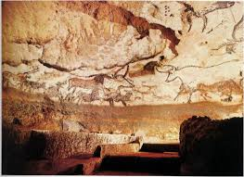
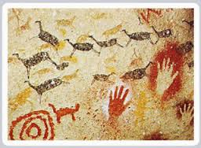
Publicly Recognizing our similarity in the pre-historical days: Local villages and lives in what is called the “ASEAN”
Good lives by the rivers, sea,
And hilly areas

Slide 5
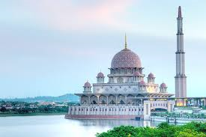
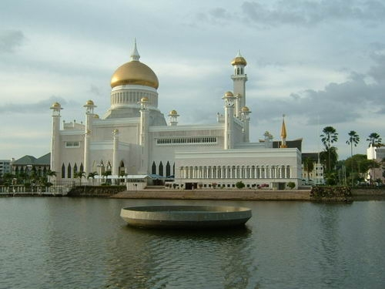
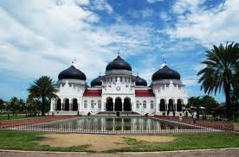
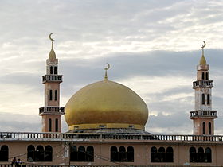

Slide 6
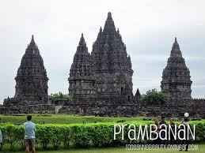
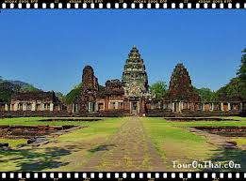
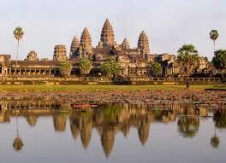
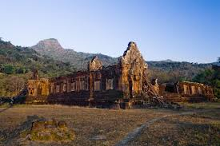
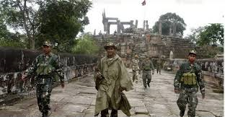
Publicly Recognizing our similarity in our history: The religious places of ASEAN

Slide 7
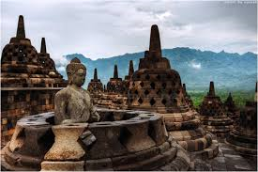
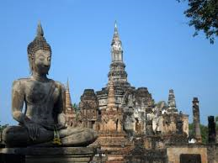
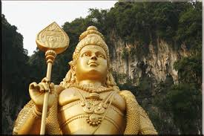
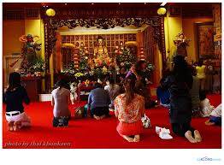
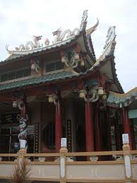
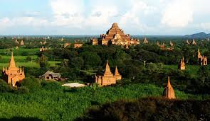
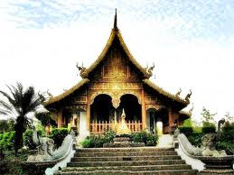
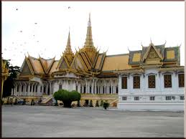
Publicly Recognizing our similarity in our history: The religious places of ASEAN

Slide 8
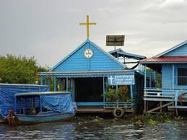
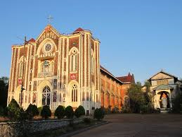
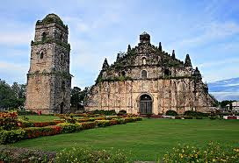
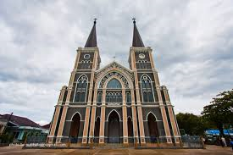
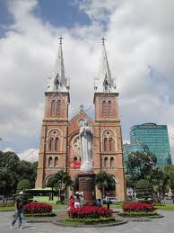
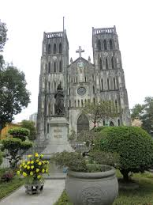
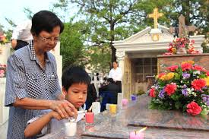
Publicly Recognizing our similarity in our history: The religious places of ASEAN

Slide 9
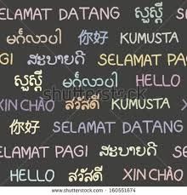
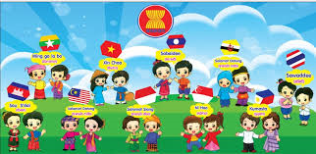
Publicly Recognizing our differences: The variety of ASEAN languages and the “similarity” in conveying message
Standardization vs Localization
English – Chinese - Bahasa –
Sansakrit - Arabic - Infographic
– Body language

Slide 10
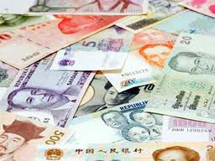
Publicly Recognizing our differences: The variety of our currencies & calculation capability
Public uses vs Business or Government Trading:
Local currencies – currency of the “leading countries” – credit card – debit “plastic” cards

Slide 11
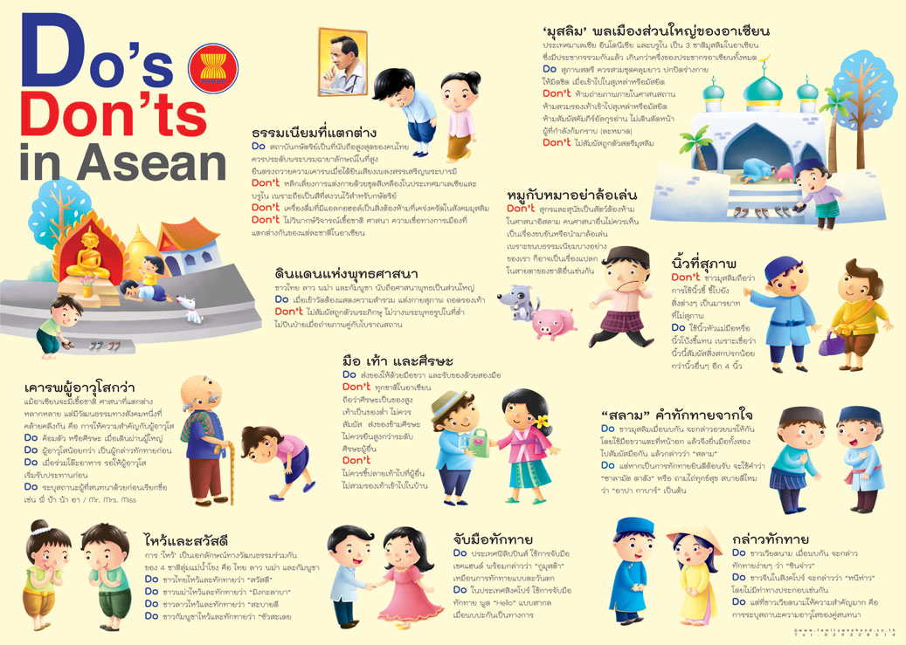
Publicly Respecting the others: The variety of our cultures & codes of conduct
Muslim Way
Respecting
others
Dogs &
Pig
Buddhist way
Using
Fingers
Using
feet
Dealing
With the
Old people
Greeting
Using
Hands
p
Face work
Interpersonal
space

Slide 12
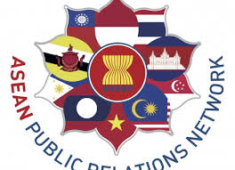
Put it into action and look for the Results: Who should play the roles in practicing PR strategies and activities in the ASEAN
PR Agencies & Clients
PR of the Civic groups/NGOs/
Associations/ Religious groups
Banking PR
PR of the Media & Entertainment Industry
PR in the healthcare industry
Etc
PR of the ASEAN Secretariat
PR of the local Governments
PR in the Business Industry
PR of the Trading Organizations
PR of the Academic Institutions

Slide 13
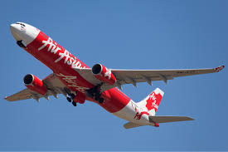
Put it into action and look for the Results: Expanding our works
from branding products, services, and managing corporate reputations
to the reuniting the ASEAN way of peacefully live in the ASEAN
Product & Services Branding
Stakeholders relations
AC information & stories sharing
Rules and regulation awareness &
actions
AE Campaigning
ASEAN Public Event
Issues management
Crisis communication
Peace building & management
ASEAN Security Stabilziation
Etc.
In offices
On airs
In news
On Lines
On wires
Off lines
Events
Activites
Publicity
Personal interaction

Slide 14
Put it into action and look for the Results: Empowering the soft culture for ASEAN Spirit
Fairs & Festivals
Movies
Television series
Game shows
Music
Concert
Musical Shows
Branded Entertainment

Slide 15
Challenging our “Public Relationships”: Framing the stories of Friends or Foes
Friends
Foes
Relatives by Bloods, Marriage & Migrations
Common Beliefs & Behaviors
Formal Invitation & Visits among leaders of the old days, and during these days.
Trading
Helping hands during the critical points in time
Local Wars of the old days
Influences from the “important” Public Figures, Values, Beliefs, Norms local people have accepted from time to time.
Power of those who were in power during the colonial days.
Etc.

Slide 16
We are now in the “same bus” driving on the same road to the final destination.
Exposure-Awareness-Acknowledge-Understanding-Attitude shift-Action-Reaction- Reproduction- Spreading news and information

