Slide 1
PUBLIC RELATIONS SOCIETY OF THE PHILIPPINES
Ethical PR Practice
Bong R. Osorio
President, Public Relations Society of the Philippines
1st ASEAN PR Summit
Batam, Indonesia
February 5, 2015

Slide 3
A little bit of history… JOSE A. CARPIO is known as the Father of Philippine PR. He saw PR as more than just publicity. He introduced the management function of PR --- A PLANNED PROGRAM of policies and behavior designed to build public confidence in and understanding of an individual or an organization. .

Slide 4
In 1957, Carpio founded the PUBLIC RELATIONS SOCIETY OF THE PHILIPPINES (PRSP), which would soon singlehandedly spur the growth of Philippine PR through seminars, training programs, workshops, awards, contacts, publications and networking. PRSP also introduced a four-year PR CURRICULUM, which was approved by the Ministry of Education and Culture, to several Philippine universities.

Slide 5
Now PRSP is the country’s premier organization of PR professionals
Has a 9-member board, Presidents’ Council, 11 Committees (PR Congress, Anvil Awards, GMM, Membership, Accreditation & Ethics, Finance/Ways & Means, Professional Development, Publicity, Publication, Student Affairs, CSR)
207 members to date

Slide 6
MISSION
Steer the country toward progress while preserving its precious heritage and culture, serve affiliate organizations to the best of its abilities guided only by the highest ethical standards, and lead the way in the development, refinement and dissemination of knowledge and skills of the profession in the Asia Pacific region.

Slide 7
VISION
Professional development of individual members
Recognition of high craftsmanship and its strategic
role in management functions
Social commitment
Proactive involvement in issues, concerns and demands of public relations and communication

Slide 8
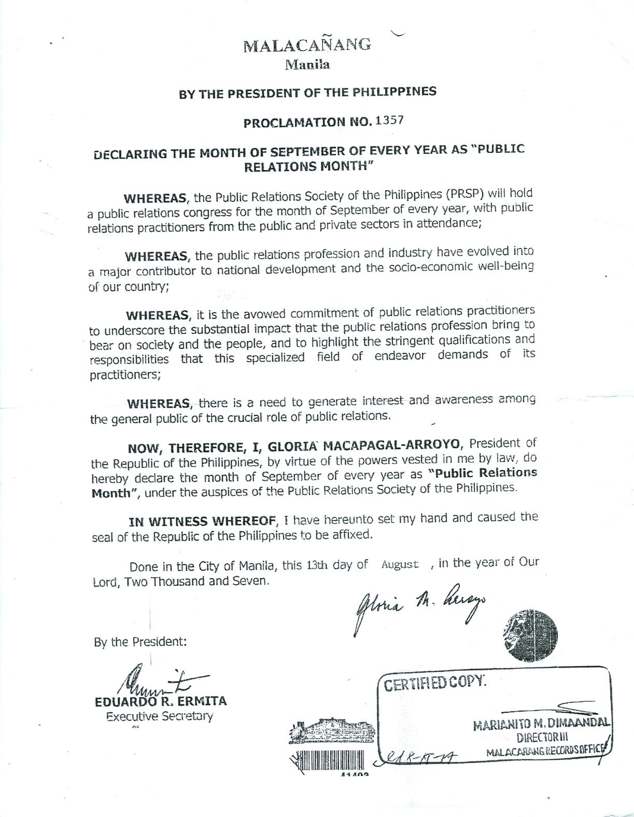

Slide 9
Presidential Proclamation No. 1357
Declares the month of September of every year as
PR month in the Philippines
It identifies the holding of the National PR Congress by the PRSP as
the PR month’s major highlight
It also puts under the auspices of the PRSP the declaration of every year
as “PR month”

Slide 10
PUBLIC RELATIONS SOCIETY OF THE PHILIPPINES
12 General Principles
of the Public Relations Society of the Philippines (PRSP)
Code of Ethics

Slide 11
PUBLIC RELATIONS SOCIETY OF THE PHILIPPINES
1. Conduct our professional way of life with the interests of the public as our basic and primary guide.

Slide 12
PUBLIC RELATIONS SOCIETY OF THE PHILIPPINES
2. Conduct our activities in full accordance with the accepted standards of trust, objectivity, accuracy and good taste.

Slide 13
PUBLIC RELATIONS SOCIETY OF THE PHILIPPINES
3. Uphold the rule of law and the dictates of public order, public policy, morals and good customs.

Slide 14
PUBLIC RELATIONS SOCIETY OF THE PHILIPPINES
4. Help promote the concept of social justice.

Slide 15
PUBLIC RELATIONS SOCIETY OF THE PHILIPPINES
5. Foster harmonious relationship and establish fair dealings at all times with other companies, fellow practitioners, the general and special publics.

Slide 16
PUBLIC RELATIONS SOCIETY OF THE PHILIPPINES
6. Protect the interest of our clients or companies by being faithful to our commitments to them, against which shall not represent conflicting or competing interests, unless full consent is given by all interested parties with full disclosure of facts.

Slide 17
PUBLIC RELATIONS SOCIETY OF THE PHILIPPINES
7. Refuse all other obligations, which hamper the effective and efficient performance of our duties to our clients and publics.

Slide 18
PUBLIC RELATIONS SOCIETY OF THE PHILIPPINES
8. Adhere closely to the established guidelines and ethics for the use of the mass media or any other channels of communication.

Slide 19
PUBLIC RELATIONS SOCIETY OF THE PHILIPPINES
9. Safeguard the confidence of our present and former clients or companies by keeping trade secrets of or other information of similar nature, unless a competent government authority, by reason of national security or public policy, orders their disclosure.

Slide 20
PUBLIC RELATIONS SOCIETY OF THE PHILIPPINES
10. Refuse any form of valuable consideration for a service, involving the profession, from any one other than our clients or companies, even if it does not involve conflicting interests, unless all interested parties give full consent.

Slide 21
PUBLIC RELATIONS SOCIETY OF THE PHILIPPINES
11. Avoid at all times pursuing any activity prejudicial to the interest of the society or inconsistent with the dictates of this code.

Slide 22
PUBLIC RELATIONS SOCIETY OF THE PHILIPPINES
12. Uphold the accepted principle of Ethics that the end does not justify the means.

Slide 23
"PR means telling the truth and working ethically – even when all the media want is headlines and all the public wants is scapegoats. Public relations fails when there is no integrity."
- Viv Segal of Sefin Marketing

Slide 24
“Ethical behavior is doing the right thing when no one else is watching- even when doing the wrong thing is legal.”
- Aldo Leopold

Slide 25
Thank you.

