Slide 1
The Strategy of Indonesian Banking Industry in Facing ASEAN Economic Community: The BNI Transformation
PT. Bank Negara Indonesia (Persero), Tbk.
Gatot M. Suwondo
Direktur Utama
Batam, 6 Februari 2015

Slide 2
ASEAN INTEGRATED POTENTIAL
ASEAN MARKET
The combined population of ASEAN creates the world’s third largest market with more than 600M people
ASEAN ECONOMY
The combined economies of ASEAN make it a major economic power
ASEAN
608,405 M
ASEAN
$ 2,323 T
Japan
127,561 M
USA
313,914 M
EU
507,890 M
India
1236,687 M
China
1350,695 M
India
$1,842 T
Japan
$ 5,960 T
China
$ 8,227 T
USA
16,245 T
EU
$ 16,584 T
ASEAN GROWTH AND INFLATION
ASEAN ECONOMICS
COUNTRY | Real GDP growth 2000-2013 | COUNTRY | Inflation rate, 2013.
China | 10 | India | 7
India | 7 | Russia | 6.5
ASEAN | 5.1 | Brazil | 6.5
Russia | 4.4 | ASEAN | 2.8
Brazil | 3.2 | Germany | 2.3
Canada | 1.9 | UK | 2.1
USA | 1.8 | China | 1.7
UK | 1.5 | USA | 1.5
Germany | 1.1 | Canada | 1.5

Slide 3
AEC AND ASEAN FINANCIAL INTEGRATION
ASEAN FINANCIAL SECTOR INTEGRATION
ROADMAP FOR MONETARY AND FINANCIAL INTEGRATION OF ASEAN
THE GOAL OF AEC
Integrating the market and production base,
A highly competitive economy,
A stable economic growth,
ASEAN economic integration with the global economy
ASEAN FINANCIAL INTEGRATION FRAMEWORK
SENIOR LEVEL COMMITTEE FOR FINANCIAL INTEGRATION
TF-ABIF
WC-FSL
WC-PSS
WC-CMD
WC-CAL
ASEAN Central Bank
Bank
LKNB
Source: Bank Indonesia
TF-ABIF : Task Force on ASEAN Banking Integration Framework
WC-FSL : Working Committee on Financial Service Liberalization
WC-PSS : Working Committee on Payment and Settlement Systems
WC-CMD : Working Committee on Capital Market Development
WC-CAL : Working Committee on Capital Account Liberalization
2003
2016
2015
2020
An Introduction of AEC at the Declaration of ASEAN Concord II (Bali Concord II) in Bali, October 2003 Planned to start at 2020.
AEC Blueprint and agreement to start earlier at the end of 2015
Starting point of Financial Services and Banking integration mainly for ASEAN-5.
AEC begin at the end of 2015 for Real Sector

Slide 4
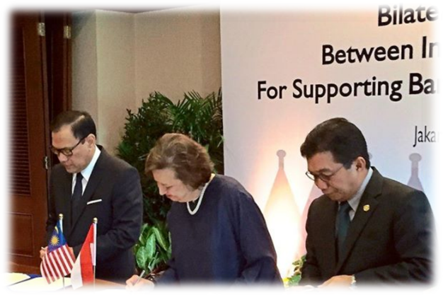
CHALLENGES FOR THE FINANCIAL SECTOR BEFORE THE AEC
ASEAN BANKING INTEGRATION FRAMEWORK (ABIF)
ABIF is a guideline for all banks in the ASEAN region to be apart of the ASEAN Economic Community (AEC), the guideline such as:
The equality of business in terms establishing branches,
The minimum assets to open a new branch,
Microcredit regulation,
Regulation to operate branchless banking,
Prioring the financial inclusion issue.
QUALIFIED ASEAN BANK (QAB)
Qualified ASEAN Banks (QAB) a system which is developed to facilitate the regional financial integration, maintain regional financial stability, and encourage growth and welfare among ASEAN members.
Principles of QAB:
reciprocal
outcome driven
comprehensive
Progressive and based on country readiness
Inclusive and transparent
Customed should be based on bilateral agreement.
Indonesia signed bilateral agreement of finance sector with Malaysia and
Singapore.

Slide 5
INDONESIAN BANKING PERFORMANCES WITHIN ASEAN BANKS
Small size, but very profitable compared to other ASEAN..
PERFORMANCE OF MAJOR ASEAN BANKS Q3 2014
COUNTRY | BANK | Assets | Capital | ROE % | ROA % | NIM %
 |  | USD Miliar
Singapura | DBS Group Holdings | 332.9 | 39.65 | 11.41 | 1.05 | 1.68
 | OCBC Bank | 391.58 | 29.1 | 14.3 | 1.17 | 1.69
 | United Overseas Bank (UOB) | 302.71 | 29.14 | 12.6 | 0.01 | 1.72
Malaysia | Malayan Banking (MayBank) | 171.34 | 15.03 | 13.31 | 1.14 | na
 | CIMB Group Holdings | 89.64 | na | 11.54 | 1.02 | 2.86
 | Public Bank BHD | 92.68 | 9.41 | 20 | 1.8 | 2.29
Thailand | Bangkok Bank | 77.87 | 10.6 | 11.9 | 1.4 | 2.44
Indonesia | Bank Mandiri | 57.61 | 6.82 | 25.12 | 3.53 | 5.87
 | Bank Rakyat Indonesia | 56.22 | 6.75 | 31.67 | 4.84 | 8.78
 | Bank Central Asia | 43.15 | 5.49 | 25.37 | 3.86 | 6.49
 | Bank Negara Indonesia | 31.58 | 4.01 | 22.65 | 3.32 | 6.13
Number of Banks in Indonesia is 119, but 10 largest account for 62% of total banking assets.
74% of banking outlets are concentrated in Java & Sumatera
The high profits of the banking sector in Indonesia could be both opportunity and a challenge for the Indonesian financial sector.
The contribution of banking industry to GDP is still low, indicating high potential for improvement…
Deposit to GDP Ratio
Loan to GDP Ratio
Source: Annual Reports 2013 from each banks

Slide 6
BNI: Value Creation – Delivered!
7 Years of Market Capital Value Creation
88 T in value created in +/- 7 years
ROI investment recovered in full Rp 7,4T Plus value created
114
Public Owned 40%
Rp 88T value created
61
26
GOI Owned 60%
Rp Trillion
BNI Recapitalized in 2000 with 61T investment by Government of Indonesia
Feb 8, ‘08
Dec 31, ‘14

Slide 7
BNI Market Capitalization Growth
An Investment in BNI stock in 2008 would be worth almost 11 times the original amount today
Source: Bloomberg

Slide 8
BNI Return On Asset Growth
Our focus on quality assets growth is demonstrated by 420% increase in ROA
Source: Bloomberg

Slide 9
THE BNI TRANSFORMATION IN FACING ASEAN ECONOMIC COMMUNITY
In the face of rapid competition and in order to strengthen the position of BNI, the company has already implemented what so called as “BNI-Reformation” that consist of two stages, those are :
Strengthening the financial basis to gain
Sustainable financial growth. Reformation program encompasses capital reinforcement, refocusing BNI Business, organization development, human resources and technology..
2009 | 2010 | 2011 | 2012 | 2013 | 2014 | 2015
 | Secodary Public offering Rp. 10 T | BNI Sec – SBI Strategy Partnership | Global bond U$ 500 Million | BNI Life -Sumitomo Strategy Partnership
Strengthening the financial basis
Sustainable financial growth
BNI
FINANCIAL
SERVICE
GROUP
2020
BNI Business Focus
“Sustainable financial growth”
Sustainable profit growth, above the average of peers group.
Strong assets growth and quality, above the average of peers group.
Sustainable service quality improvement.
Business Banking:
Focus on 8 leading industries
Consumer & Retail:
To be a lifetime banking partner

Slide 10
BNI Tier – 1 Capital Increase
Quality Growth has enabled BNI to grow its Tier-1 capital 160bps since 2008, the highest gain among our peers and prepared to grow further in new environments
Source: Bloomberg

Slide 11
BNI NPL Reduction
BNI’s reduction in NPL levels by over 290 bps leads our peer group
Source: Bloomberg

Slide 12
BNI Efficiency Ratio
BNI 90bps improvement in Efficiency Ratio since 2008 is leading our peer group performance
Source: Bloomberg

Slide 13
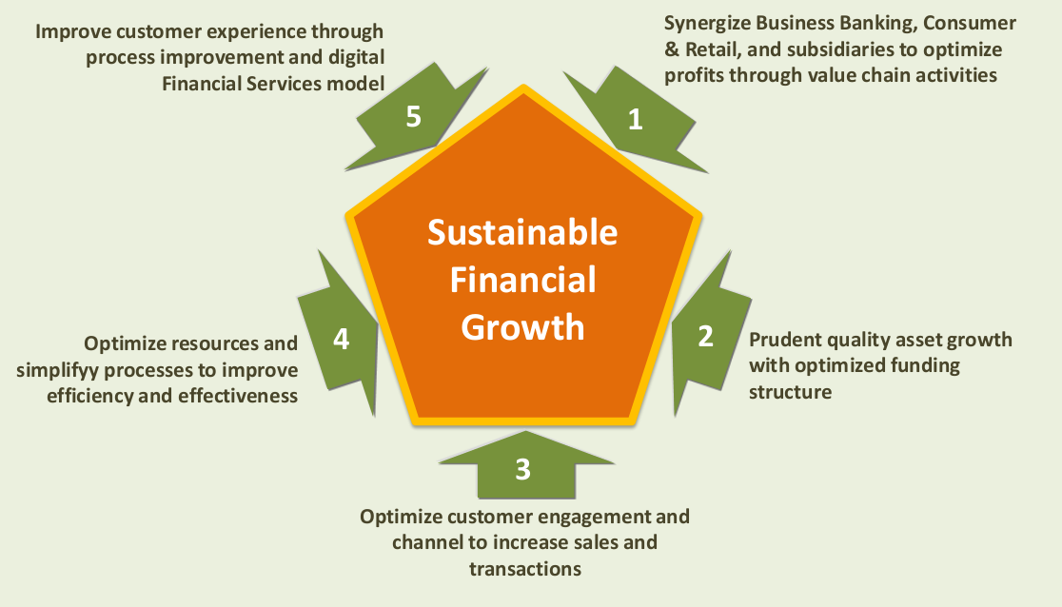
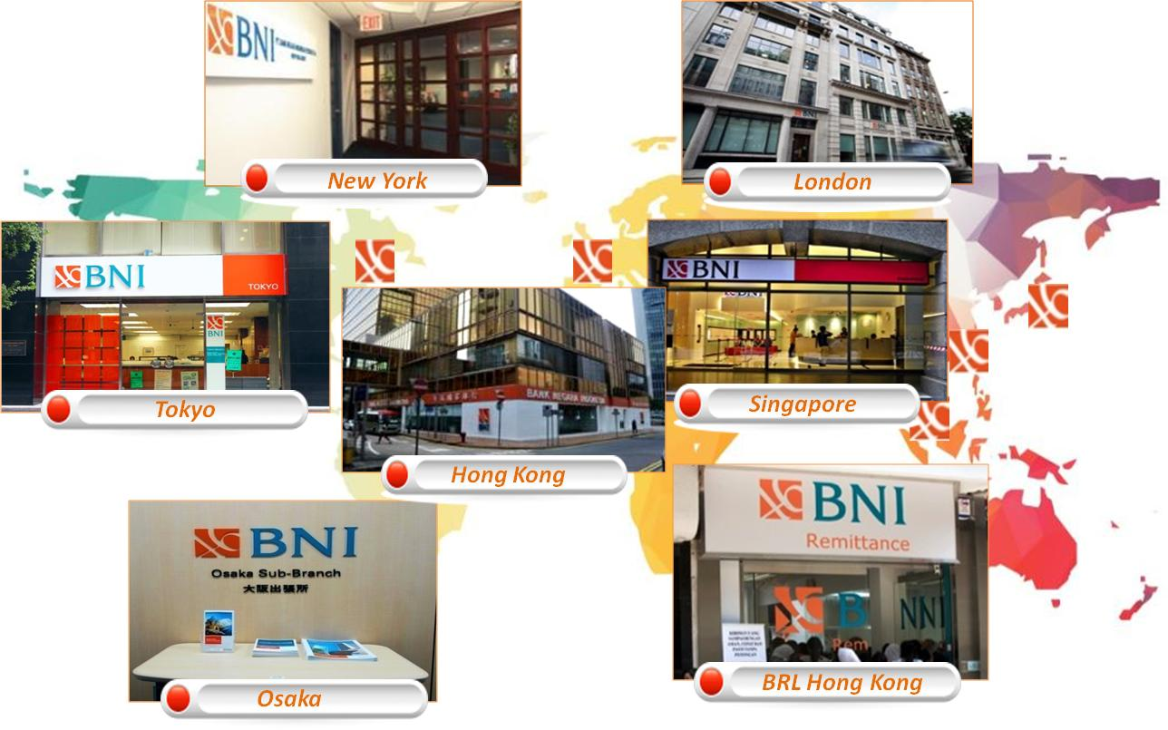
BNI : BRIDGING INDONESIA & THE WORLD
Bridging Indonesia and The World
In 2015, BNI is committed to continue the policy to encourage sustainable growth, by directing efforts towards the realization of a global-capable domestic bank that act as a link between Indonesian citizen and International community. It is expected to become a gateway for foreign investors willing to invest in Indonesia.
This is reflected by BNI’s commitment to continuously expand its overseas business. BNI is Indonesia local bank with the most extensive overseas network including 5 overseas branches (Singapore, Japan, USA, UK, and Hong Kong), 1 subsidiary of BNI remittance limited (BRL Hong Kong), 1 sub-branch BNI Osaka-Japan, and 1.637 bank correspondents around the world. In addition, BNI also opened Remittance Representatives (RR) in Malaysia, Brunei, Dubai, Qatar, and Bahrain,
Currently, BNI is under the process of building a representatives office in Yangon, Myanmar as well as building a new offices in Jeddah, Saudi Arabia and South Korea

Slide 14






BNI : BRIDGING INDONESIA & THE WORLD
Optimizing the role of BNI International networks….
Domestic BNI (Indonesia)
International Branches
Client Domestic Value Chain
International
Network
Key Products:
Trade Finance
Loans
Supply Chain
Securities
Remittance
Bank Services
Client Overseas Value Chain
Business Banking
Business Banking
Suppliers, distributors, consumers
Suppliers, distributors, consumers
BNI domestic client
Overseas operations of client company
Correspondent Banks, Remittance Agencies
“Bridging Indonesia and The World”
The role of overseas branches will be a business catalyst between Indonesia and the world through strategic steps as follows:
Probing Indonesia related business opportunities (Business Origination for Indonesia related)
Supply financing that associated to “Indonesia related business”
Improving fee based income (transactional banking) contribution to total income.
Developing overseas branches as BNI center of excellence
Improving the role of overseas branches as “BNI Ambassador” in the relationship with investors, regulators, local authorities and counterparts (Bank and Non Bank)

Slide 15
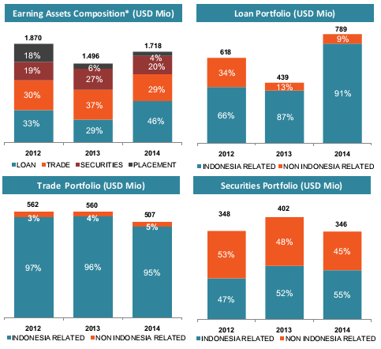
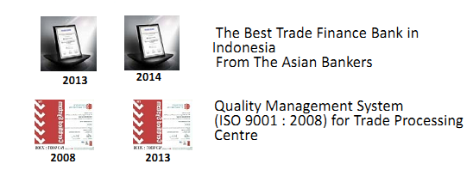
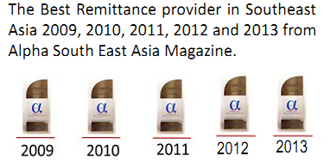
BNI : BRIDGING INDONESIA & THE WORLD
“Bridging Indonesia and The World”...
Overseas Business Performance BNI continues to grow. At 2014 BNI overseas credit portfolio has reached USD 789 million, with growth of 79%.
BNI international business strategy is to focus on "Indonesian Related Business", as BNI wants to facilitate Indonesian businesses that want to expand into Regional or global marker, or international businesses that want to do business with Indonesia. This is in line with the motto of BNI:
"Bridging Indonesia and TheWorld"
Source: BNI Corporate Presentation FY 2014

Slide 16




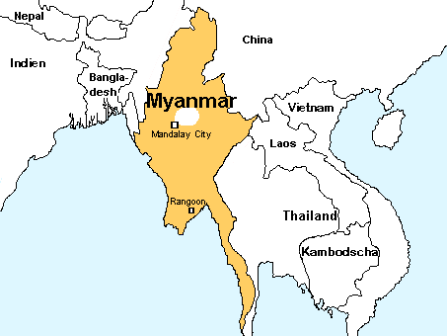




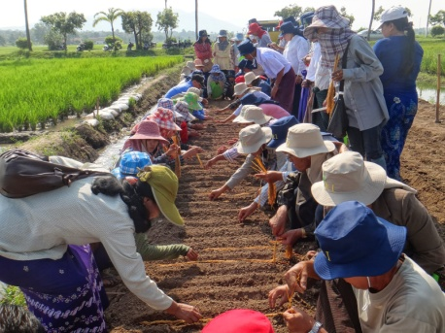


THE SYNERGY OF BNI AND OTHER STATE-OWNED COMPANY
TO PENETRATE MYANMAR’S MARKET
Myanmar is one of the attractive market in ASEAN because it is still relatively less developed, thus very potential to work on
15 state-owned enterprises such as PT. Timah, PT, Bukit Asam, PLN, Semen Indonesia, PT. Pupuk Indonesia, Bulog, Garuda Maintenance Facilities, PT. Telkom and BNI under the coordination of State-Owned Enterprise Ministry plan to expand to Myanmar
BNI will act as a loan and Scheme coordinator of State-Owned Enterprises that are planning to expand to Myanmar
If BNI opens its outlet in Myanmar, then BNI will become the first national bank to operate in Myanmar. This will add to existing BNI International network (Singapore, London, Hong kong, Tokyo, Osaka and New York)
“BNI as a loan and scheme coordinator”
Myanmar
“Build a 10 thousand Hectare tin mine”
“Build a 2x20 MW mine mouth power plants”
“ Improving effectiveness through reduced electricity losses”
“Build a cement plant with market up to Vietnam ”
“Build a fertilizer plant”
“Rice Trading
“Maintenance service for the aviation industry in Myanmar”
“Being a mobile operator in Myanmar”
Notes:
(Note: this slide only Illustrate a SOE strategic alliance in infrastructure projects)

Slide 17
THANK YOU

